Slide 1



How to improve data capture and promote local quality improvement through IT
Jose Lourtie
NELA Project Manager
Royal College of Anaesthetists
Mark Kavanagh
SSNAP Programme Manager
Royal College of Physicians
Notes:
I’m here today to talk to you about the National Emergency Laparotomy Audit – and how IT is facilitating and improving data collection and entry, and how we are using IT to assist participating sites carry out local quality improvement.

Slide 2
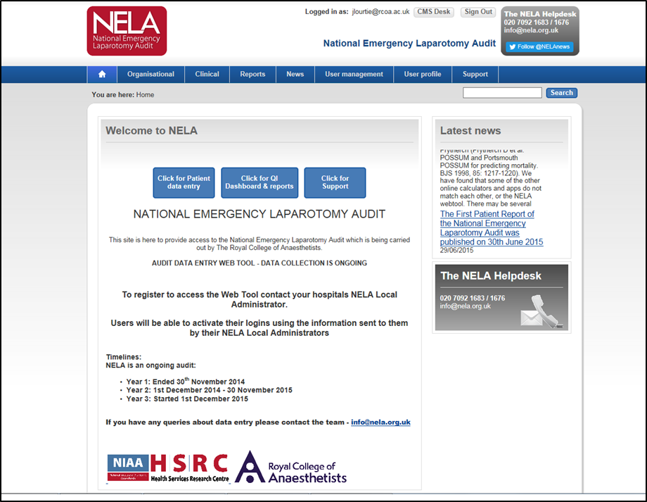
The online NELA webtool is simple and easy to use:
Quick click button for data entry
Quick click button for the QI Dashboard & Reports
Quick click button for Support
Notes:
Like the Stroke audit we use NetSolving and have a long term working relationship with them. We have benefited from their expertise and have piloted some innovative methods of feeding back data being collected:
Like stroke we provide an export function to get the raw data in an excel spreadsheet
We have also been working on providing participating sites with real-time data feedback. Which can be easily accessed via the online webtool.

Slide 3
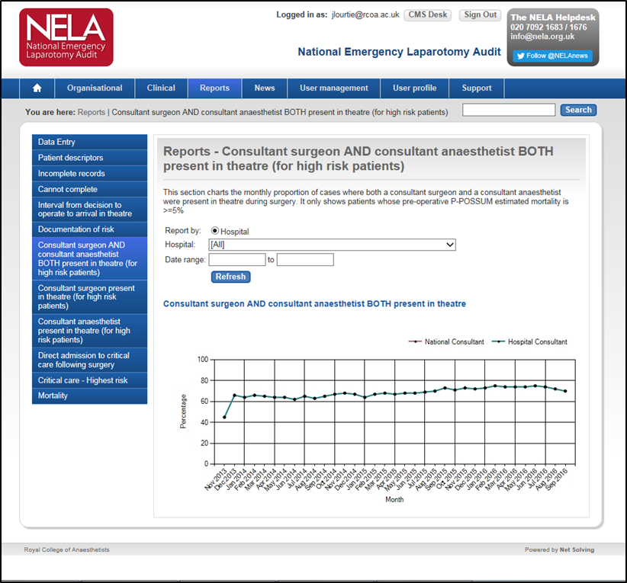
NELA QI Dashboard
What’s available:
Key QI indicators and audit measures (with more being added all the time)
Focus on Case Ascertainment & assisting with Data entry
Allows for data to be easily viewed and interpreted
Provides real-time feedback of local data
Comparison to National average
Export own data
Notes:
The NELA dataset and Webtool are designed to encourage prospective data entry.
This means that as participating sites are entering, completing and then locking each individual patient case this information is then made available for them to analyse via the online QI Dashboard.

Slide 4
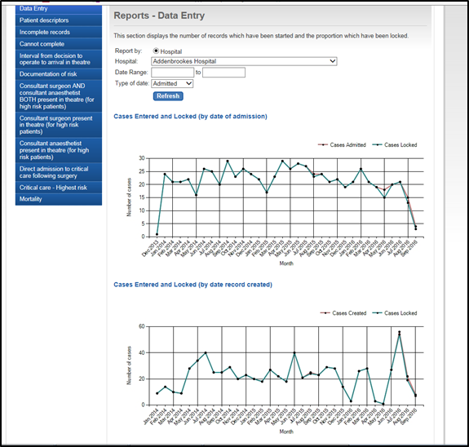
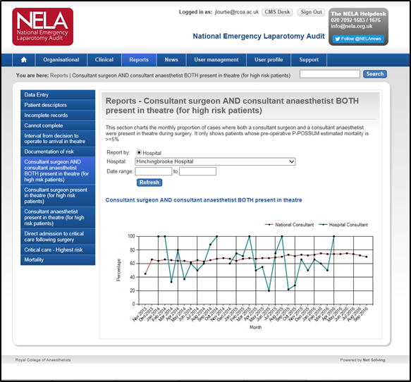
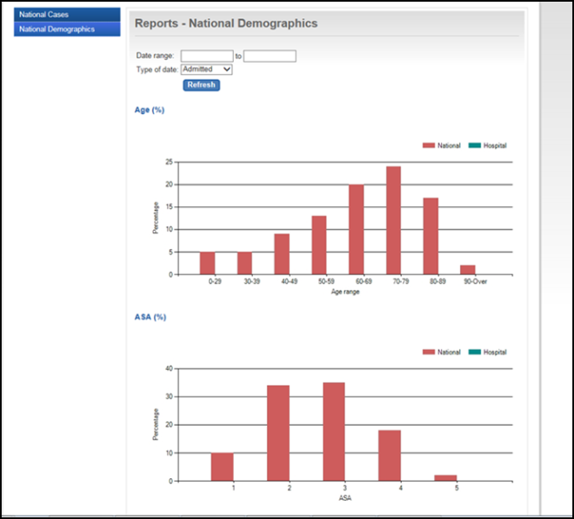
Comparison to National average
Case Ascertainment
Notes:
- Key indicators can be viewed in graph form. These can be downloaded to be used in local presentations
Participants are also able to see the progress being made with entering cases and how many incomplete / locked / complete cases they have on the webtool
The data for the key indicators is provided real-time and is updated as soon as a case is locked
A national average is also shown to allow for comparison

Slide 5
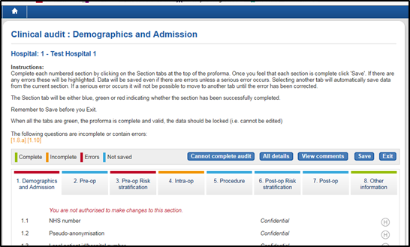
Custom Fields
Hospitals using custom fields:
Royal Preston Hospital
The Royal Bournemouth Hospital
Ysbyty Gwynedd Hospital
Glan Clwyd General Hospital
Wrexham Maelor Hospital
Medway Maritime Hospital
The Queen Elizabeth Hospital
Bedford Hospital
Royal Victoria Hospital
Studies / Research using custom fields at local hospitals:
Adoption of Lung Protective Ventilations Strategies in Patients Undergoing Emergency Laparotomy (ALPINE)
Emergency Laparotomy Collaborative (ELC)
Notes:
Custom Fields – On the webtool there is the facility to allow local hospitals to collect their own data alongside the full audit dataset. In Section 8 it allows for ‘Custom Fields’ to be added.
Several sites are already making use of this facility
It allows for further QI work to take place locally and provides encouragement to enter the data
We have also worked with small studies that are taking place across multiple sites. They have worked with local leads and then the webtool facilitates their data collection. This allows for regions to work together and carry out QI initiatives

Slide 6
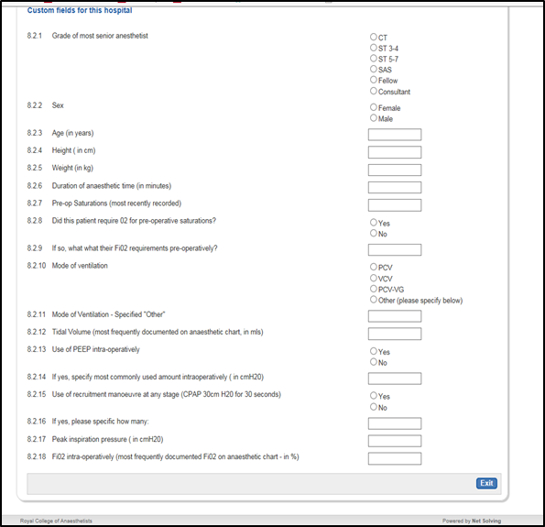
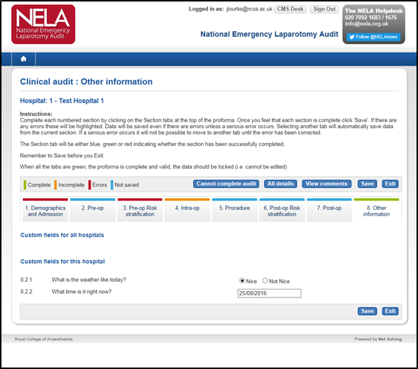
Custom Fields
Example:
Example:
Notes:
Here are some examples of how it looks and works

Slide 7
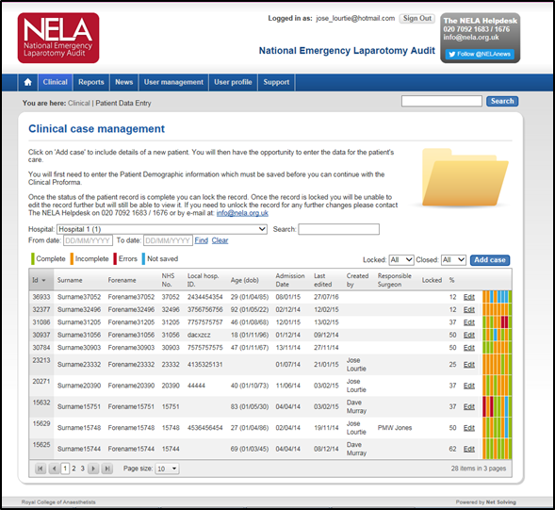
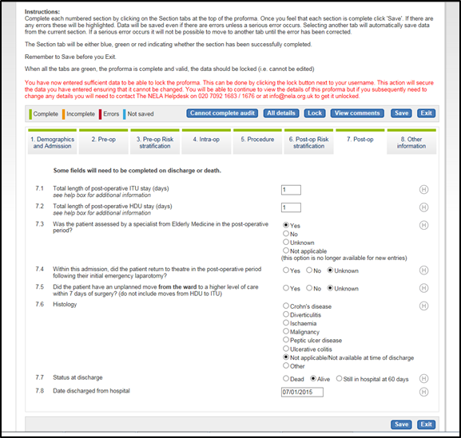
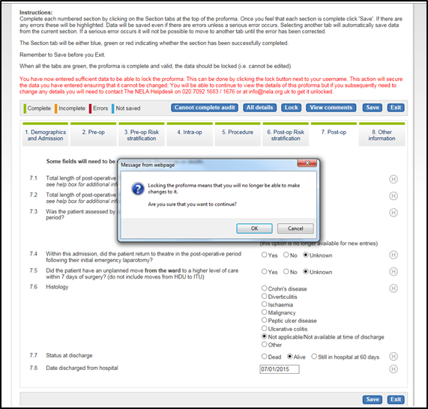
Data completion & Submitting (Locking) Cases
Simple – colour coded for easy to see progress for individual cases
Once complete case goes green allowing it to be locked
Double checking that data is ready to be submitted
Notes:
The webtool is very intuative:
Simple colour coded sections allow to see the progress of each individual patient case
All green then it is complete
Is secure and ensures that when data is locked local users are satisfied it can be submitted to the audit

Slide 8
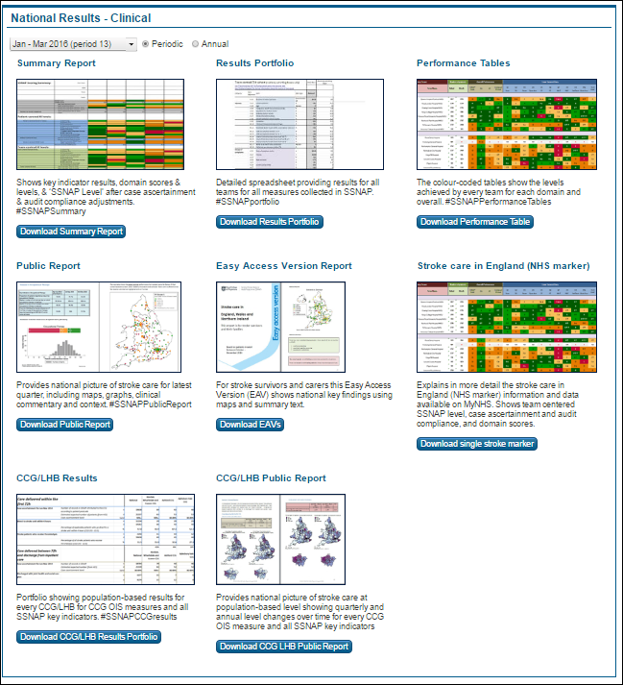
Engaging results area with specific permissions
Clinicians, commissioners, researchers, SCN’s, local authorities and more NHS groups can access results on the webtool
Accessing for any time period results is intuitive, and requires only a couple of clicks on a mouse
Permissions can be set against different user types so they can access only specific reports at defined time periods
This means that latest results can be disseminated in stages – teams ,to clinical networks, to wider NHS professionals, to public domain
Clinical teams therefore have the opportunity to review and discuss their own results before they are made more widely available

Slide 9
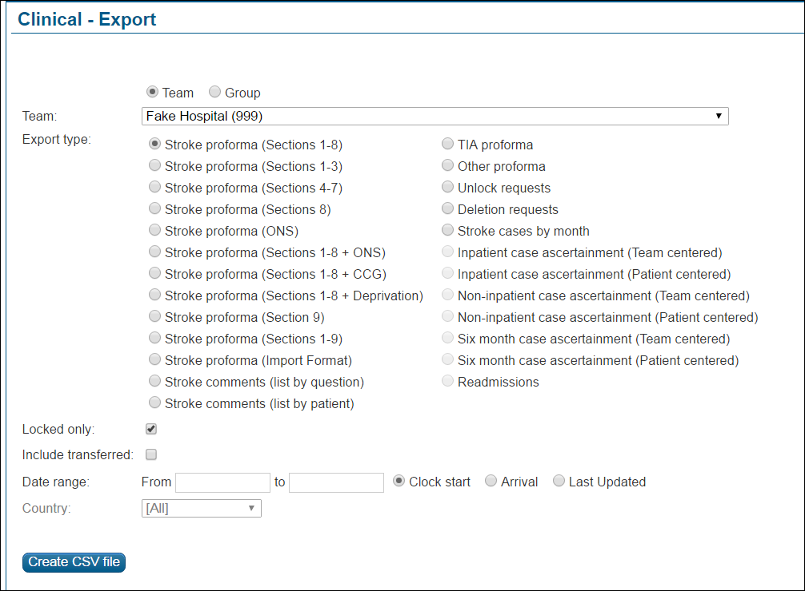
Export function on SSNAP
Ability to export locked records on SSNAP at any time for local reporting
For local analysis and quality improvement work between official SSNAP reporting periods
Specific sections of the dataset can be selected
Set custom date ranges for weekly/monthly analysis
Custom fields can be exported to and analysed for quality improvement projects
Allows teams to find out where immediate improvements are required in key areas of care

Slide 10
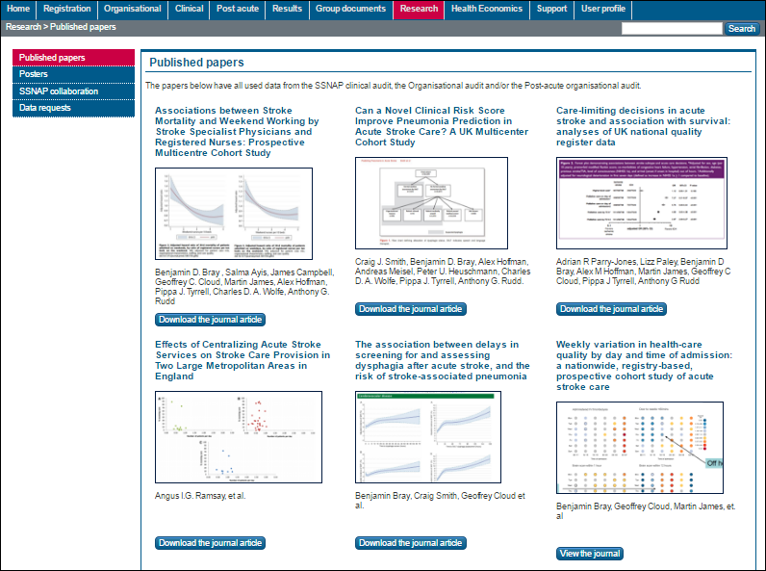
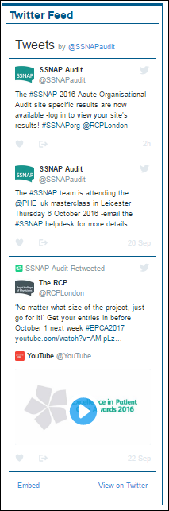
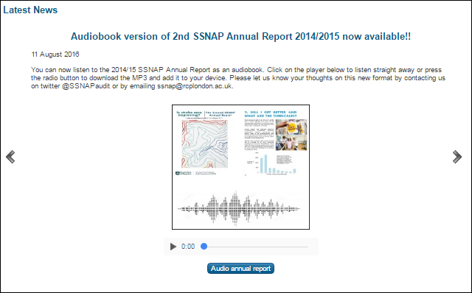
Accessible front facing which can be updated inhouse
Webpages can be created and updated by the SSNAP team quickly and effectively
Ability to create new areas of the webtool to promote new outputs, projects, and audit developments
This can include new tabs, text, images, radio buttons, reports
Can check everything is functioning correctly on test sites before launching it on live site
Ensures webtool remains useful, relevant and provides timely information to users

Slide 11
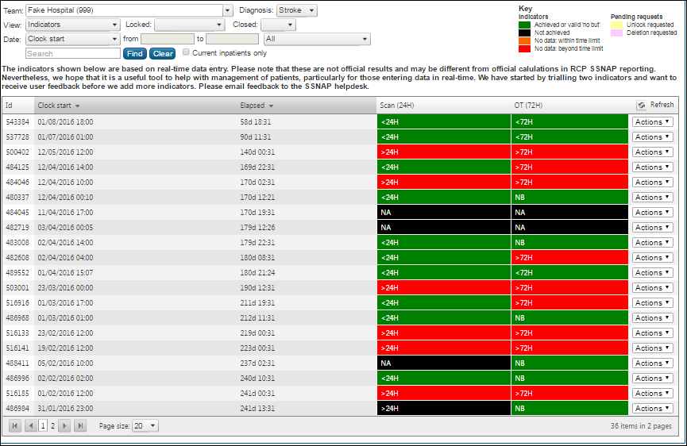


Real time indicators for each patient record
Real time indicators available for every new patients record started on SSNAP
Time bound indicators show teams what measures of care have been completed and what still need to be done in real time
It shows if an indicator has been achieved and how much time is left to complete it – for example
This encourages regular review of patient data, prospective ‘real time’ data entry, and using the webtool as a resource for quality improvement
“The information is really useful and is good for being able to highlight issues (eg breaches) as they arise, rather than waiting to report at the end of the month” – Dorset County Hospital
“This new FANTASTIC feature gives us visual and real time information on whether the above standards are met and explore straight away potential issues and strategies to implement for improvement” – University College Hospital London

Slide 12
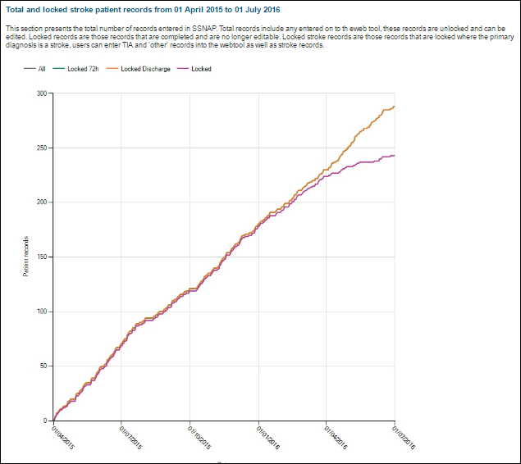
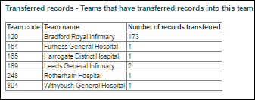
Numerous features to aid data entry and encourage regular reviews on activity and performance
Customisable reports available to teams to review activity and ensure all data has been entered completely and accurately.
Ability to filter to view only specific information such time periods, record completion status’,
Create bespoke ‘unlocked records’ reports to check what still needs to be completed and locked ahead of each data locking deadline
This helps to ensure case ascertainment requirements are met and that data submitted to SSNAP are complete and of high quality
“Thank for your help, the new filters have encouraged me to try and sort out all the oddities, I am finding them really useful at the moment” - West Suffolk Hospital
“Just to say a big thank you for the ‘unlocked records report’ it is brill!!! – South Tyneside Hospital

Slide 13
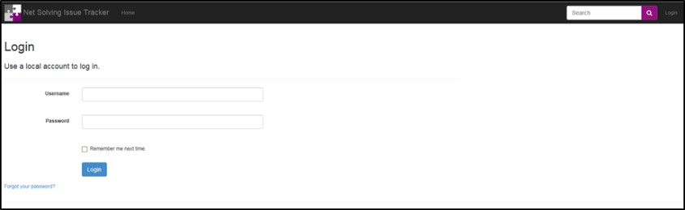
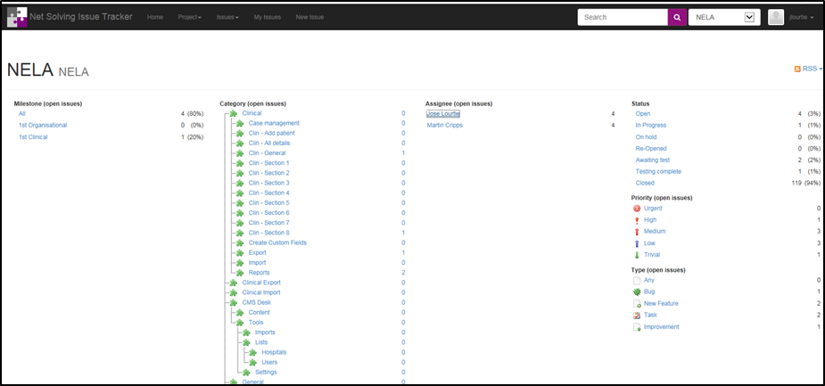
NetSolving Support
Issue tracker
Help / support
Easy to contact via telephone or email
Quick response and assistance
Notes:
NetSolving also provides a useful Issue Tracker:
This allows for those administrating the running of the audit to request assistance on any problems, ask for an update or an improvement to the webtool
It keeps track of the progress and automatically assigns workload
Gives a good indication of the work being carried out
NetSolving are very responsive when they are contacted – Telephone or email

Slide 14
ANY QUESTIONS?
More information at: NELA.ORG.UK and strokeaudit.org
Follow us on: @NELANews @SSNAPaudit
Email: jlourtie@rcoa.ac.uk or mark.kavanagh@rcplondon.ac.uk
Notes:
Thanks very much…. Any questions

